Slide 1
U.S. Treasury Data Transparency Town Hall
September 26, 2014
Campbell Pryde, President and CEO,
XBRL US

Slide 2

U.S. Treasury Data Transparency Town Hall
Standards

Slide 3



U.S. Treasury Data Transparency Town Hall
Faster, Cheaper, Accurate, Detailed

Slide 4
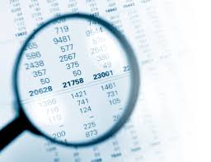
U.S. Treasury Data Transparency Town Hall
Transparency

Slide 5

U.S. Treasury Data Transparency Town Hall
Lessons Learned

Slide 6
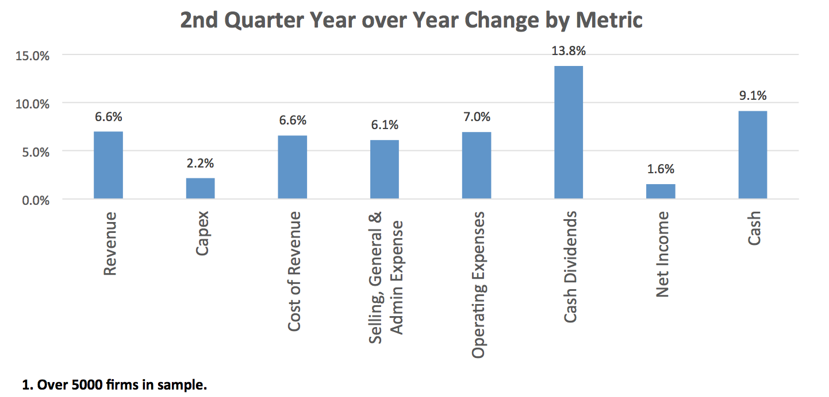
U.S. Treasury Data Transparency Town Hall
Improving Access

Slide 7
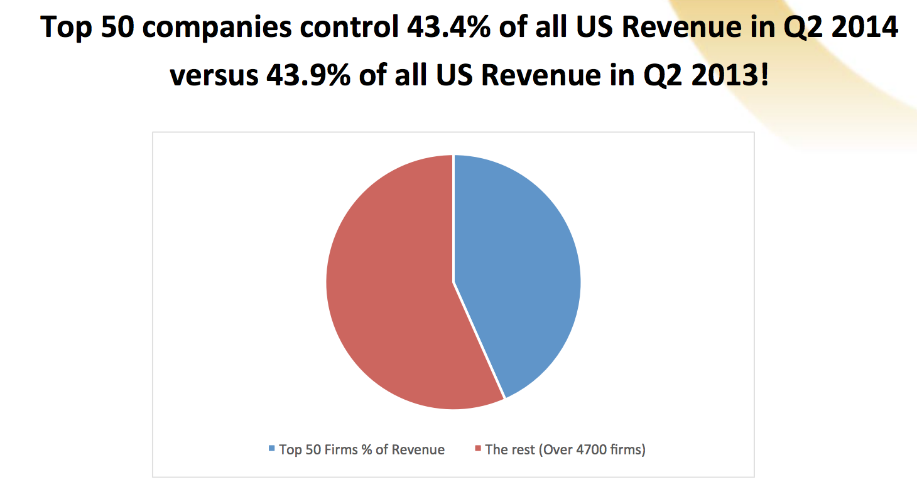
U.S. Treasury Data Transparency Town Hall
Improving Access

Slide 8
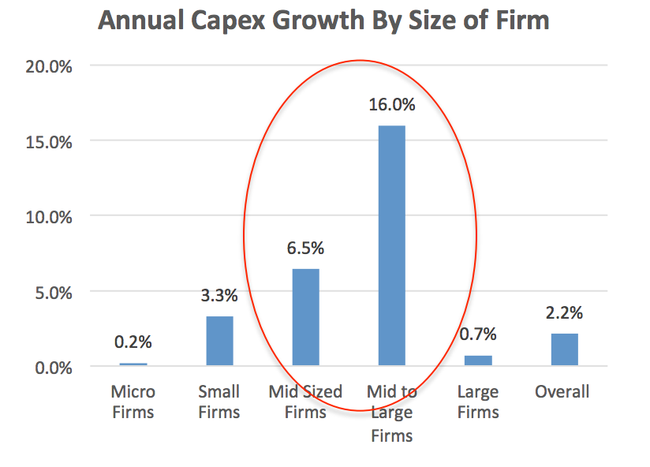
U.S. Treasury Data Transparency Town Hall
Improving Access

Slide 9
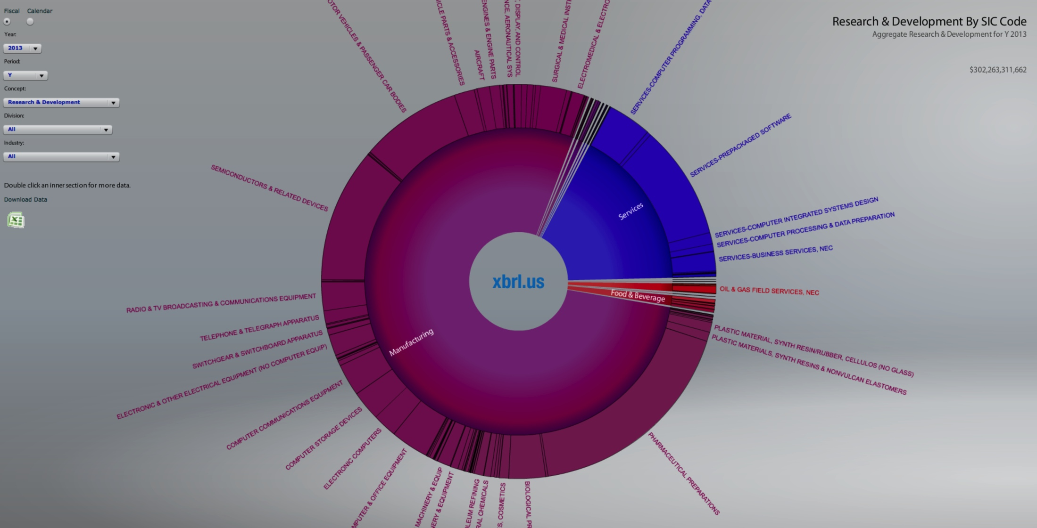
U.S. Treasury Data Transparency Town Hall

Slide 10
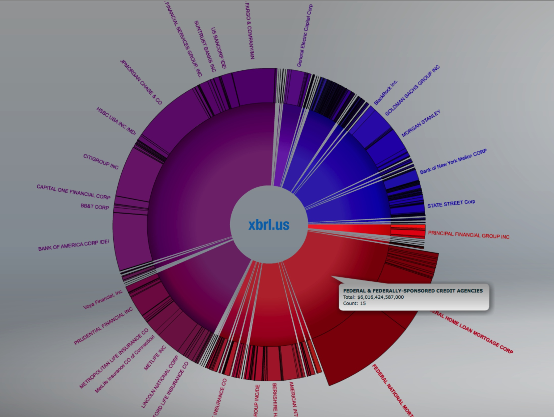
U.S. Treasury Data Transparency Town Hall

Slide 11
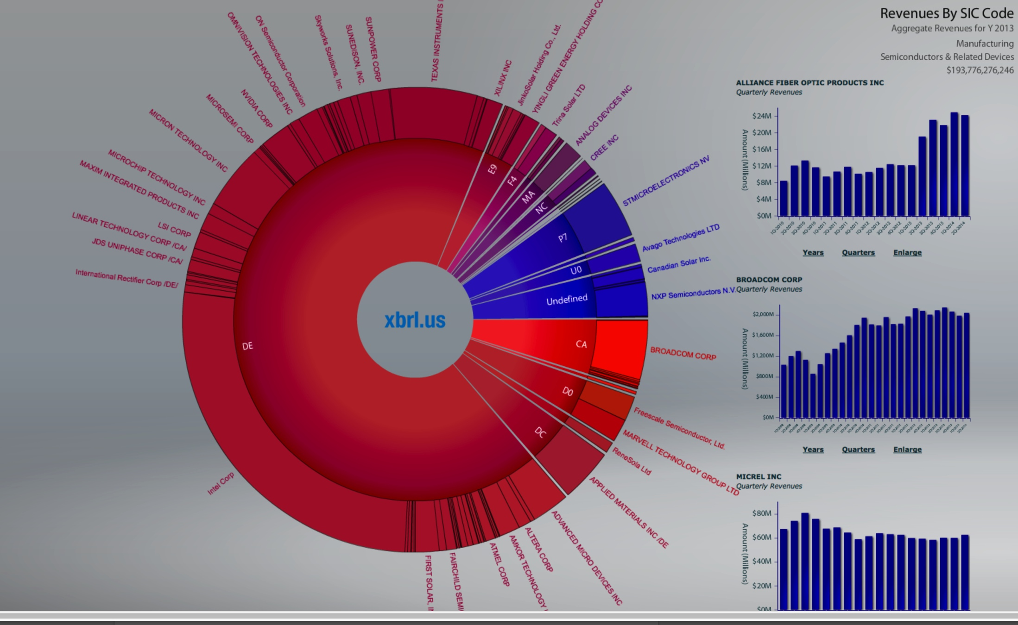
U.S. Treasury Data Transparency Town Hall

Slide 12
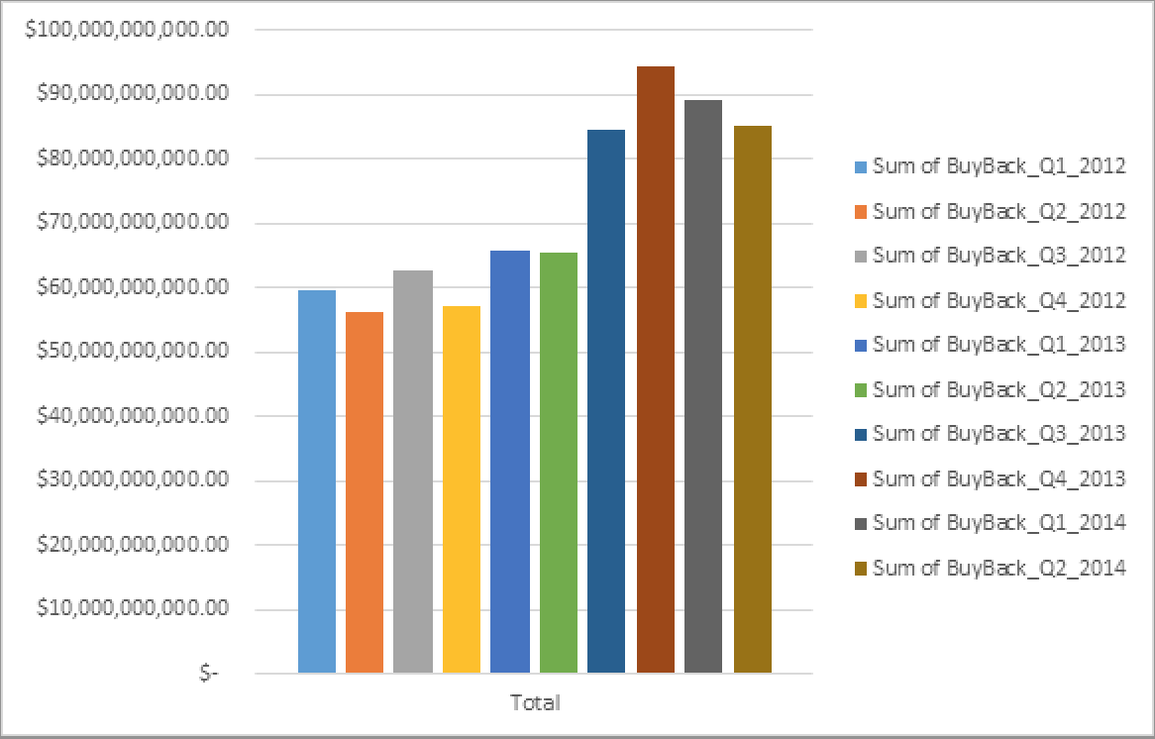
U.S. Treasury Data Transparency Town Hall
Share Buy Backs S&P 500

